Slide 1
Dell EMC Unity All-Flash
Transforming Your Datacenter

Slide 2
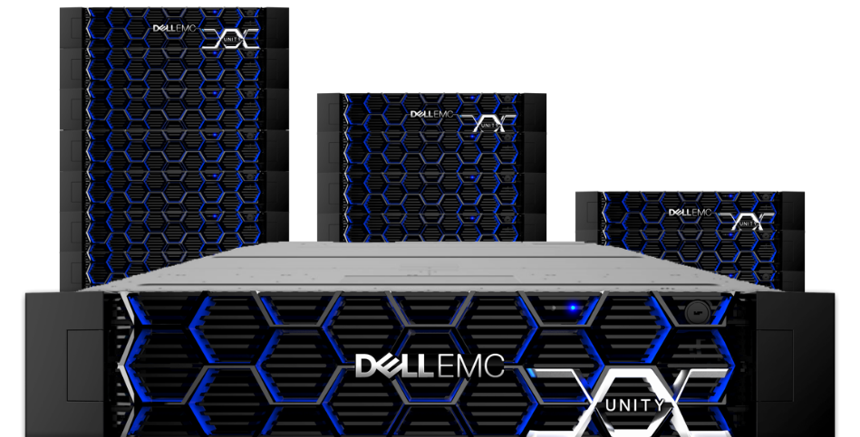
Dell EMC Unity Momentum since May 2016 Launch
Bookings: $2.5+ Billion
Capacity: 2,750+ PB
Systems: 27,700+
Customers: 10,800+
*As of August 2018
https://blog.dellemc.com/en-us/2-billion-in-less-than-two-years-dell-emc-unity-storage
2
© Copyright 2017 Dell Inc.

Slide 3
Meeting the Midrange IT Challenges
Mounting pressure to do more with less
Cost Effective
Budget shifts
Managing IT infrastructure
For any budget or situation
Empower IT personas
Increasing pace of business growth
Future Proof
Managing excessive data growth
Affordable cloud adoption
Any deployment strategy
Any protection strategy
Any workload (file/block)
Any protocol, network
Difficult to choose the right IT Provider
Uniquely Qualified
Product-only vendors
Must minimize risk
Full HW/SW portfolio; #1 Leader
Proven customer focus
Storage lifecycle complexity
Lifecycle Quality
Acquisition, Configuration, Management, and Support
Self-optimizing architecture
Self-service and support
Easy web ordering
All-inclusive software options

Slide 4
Enterprise-class Capabilities
Mid-tier Economics
COMPLETE SW PORTFOLIO
ALL-INCLUSIVE @ NO ADDITIONAL COST
INLINE EFFICIENCY
INLINE DATA REDUCTION
UNIFIED
UNIFIED FILE & BLOCK DATA
INTEGRATED HYBRID CLOUD
UNIFIED CLOUD TIERING
Notes:
SC Series
INTELLIGENT EFFICIENCY
POST-PROCESS INTELLIGENT DEDUPE + COMPRESSION ▪ ALL-FLASH OR HYBRID
FEDERATED
LIVE VOLUME MOVE ACROSS MULTIPLE SYSTEMS ▪ METRO DR ▪ LIVE MIGRATE BETWEEN SYSTEMS
BEST ECONOMICS
LOW ENTRY PRICE ▪ LOWEST $ / GB ▪ LOWEST $ / IOPS ▪ PERSISTENT LICENSE & ALL-INCLUSIVE OPTIONS
Unity
INLINE EFFICIENCY
INLINE COMPRESSION + ZERO DETECT + DEDUPLICATION ▪ BUILT FOR ALL FLASH
UNIFIED
UNIFIED FILE & BLOCK ▪ APPLIANCE, SDS OR CONVERGED ▪ ONLINE DATA IN PLACE UPGRADES
INTEGRATED HYBRID CLOUD
ARCHIVE OR BACKUP SNAPS TO REMOTE AND CLOUD ▪ TIER FILES TO CLOUD

Slide 5
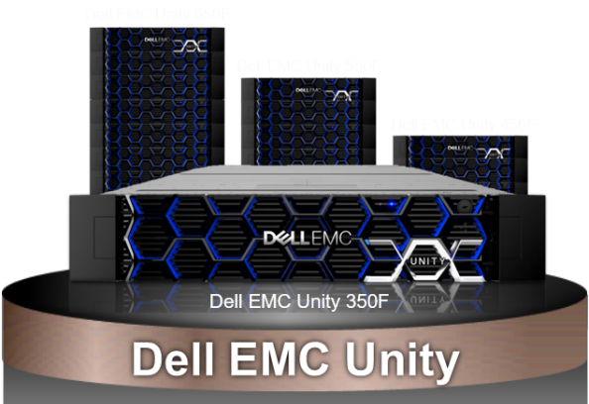
Dell EMC Unity overview
Optimized for All-Flash simplicity, performance, cloud
MORE POWER
4 All Flash Intel Broadwell models
More cores; more memory
613TBe per rack unit All-Flash density
MORE FILE POWER
256TB File System
Sync/Async file replication
Metrosync Manager
File Level Protection
INTEGRATED COPY DATA MANAGEMENT
AppSync support
Snapshot mobility
Thin Clones
SECURE
D@RE internal & external key mgmt
DOD approved
INVESTMENT PROTECTIION
Built-in block & file data migrations
Online Data-in-Place upgrades
2-Way NDMP
Third Party Data Migrations
ALL INCLUSIVE SOFTWARE
Unified inline data reduction
Full unified replication suite
Data protection features
Dynamic pools
CLOUD INTEGRATIONS
Software Defined Storage in the Cloud
File tiering & block snapshot archiving
Cloud-based storage analytics
Validated with VCF Building Block
100% UNIFIED
SIMPLE TO SETUP, MANAGE & USE
Notes:
The new Dell EMC Unity All Flash Array (AFA) models bifurcate from what we have had in Unity to date. To date both the Dell EMC Unity AFA and Hybrid systems used the same intel processors, had the same number of cores, and the same amount of memory.
Now with the Dell EMC Unity 350F through 650F, we have more Intel core and twice the amount of memory. The increased performance is there to support the inline efficiency features that will be coming in future releases.
Note the existing Dell EMC Unity 300F through 600F will continue to be sold and they will run the new Unity OE V4.2 code, but we expect customers to quickly transition to the new models.
The Dell EMC Unity 350F through 650Fs are truly powerhouses of computing capability. Let’s take a quick look at some of the new systems’ specifics.
Gemalto – SafeNet KeySecure
IBM – Security Key Lifecycle Manager

Slide 6
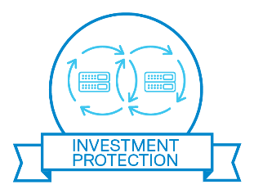
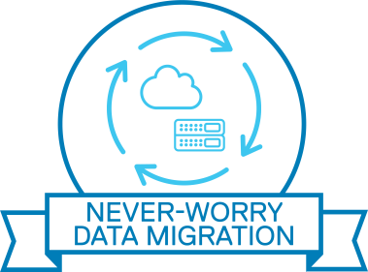
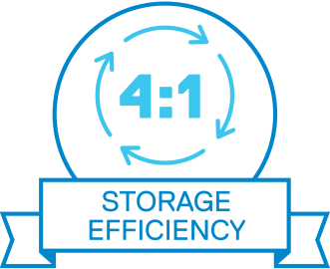
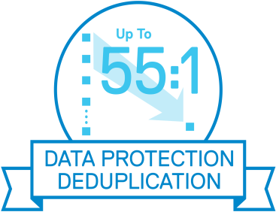
Peace of mind
No hidden costs or fees
Investment Protection
Lowering the risk of your investment
A Path forward
You will be ready for the future
3-YEAR SATISFACTION GUARANTEE
INVESTMENT PROTECTION
PREDICTABLE SUPPORT PRICING
NEVER-WORRY DATA MIGRATION
4:1 STORAGE EFFICIENCY GUARANTEE
ALL-INCLUSIVE SOFTWARE
UP TO 55:1 DATA PROTECTION DEDUPLICATION GUARANTEE
FLEXIBLE CONSUMPTION MODELS
CLOUD MOBILITY, PROTECTION AND MANAGEMENT
Notes:
The Future-Proof Loyalty Program is a customer facing program designed to provide investment protection with a set of world class technology capabilities and programs to provide value for the entire lifetime of your applications. The Future-Proof Loyalty program is different because it is available to customers at no additional cost either in terms of higher maintenance price or higher product price. The Dell EMC Program leverages the strength of Dell Technologies to offer the industry’s strongest and most encompassing loyalty program.
3-year Satisfaction Guarantee. The product will do what we say it will do, and if you’re still not satisfied, we will repair, replace, or give you money back.
Hardware Investment Protection. Your hardware will keep its value, from purchase through upgrade.
Predictable Support Pricing. Clear and predictable prepaid and renewal support pricing.
Never-Worry Data Migrations. We make it simple to move to the next generation.
4:1 All Flash Storage Efficiency Guarantee. We guarantee the effective capacity of your all flash array.
All Inclusive Software. You get a functional, useable system with a single purchase.
Up to 55:1 Data Protection Deduplication Guarantee. Data reduction for data protection appliances
Cloud Consumption. which aligns with the Dell Financial Services options for flexible consumption models based on the type and usage of our cloud offerings.
Cloud Enabled. which addresses the mobility, protection, and management of data and applications in the cloud.
Future-Proof provides customers with investment protection, peace of mind and a path forward.

Slide 7
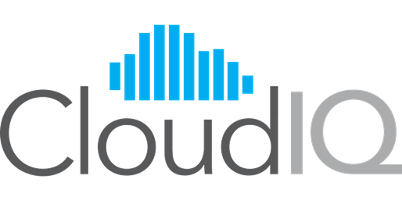
Manage your entire storage infrastructure from anywhere, via the web
Cloud-based storage analytics
Included with every midrange array: NO ADDITIONAL COST & NOTHING TO INSTALL
Efficiency Ratios
Flash Gauge
Performance Anomalies
SW Update Notifications
Purpose-built for the cloud
Native cloud application
Built on the Pivotal Cloud Foundry
Applied machine learning
Proactive monitoring, predictive analytics, remediation
Comprehensive health scores for your arrays
New features added non-disruptively in the cloud
Independent secure portal per customer
Dell EMC Unity
SC Series
Storage Array Health Scores

Slide 8
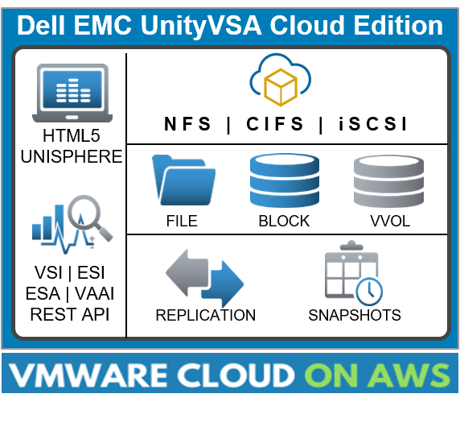
Dell EMC UnityVSA Cloud Edition
Full featured SDS capabilities now deployed in the Cloud
Deploy Dell EMC Unity SDS with VMware Cloud on AWS
Use Dell EMC Unity industry-leading unified features for your cloud environment
File, Block and VVol
Utilize Dell EMC Unity native data replication for migration and re-purposing
Experience the same Dell EMC Unity look and feel as on-premises
Ideal for dynamic file and block storage needs
Test/dev, disaster recovery, rich media, genomics, IoT and more
Notes:
Dell EMC Unity has consistently provided leading deployment flexibility, including purpose-built hardware, converged infrastructure and software-defined storage with UnityVSA, as well as multiple capabilities that leverage the capabilities of the cloud (data protection, archiving and global management).
Now Unity takes deployment flexibility and cloud utility even further, with the new Dell EMC Unity Cloud Edition. Users will be able to deploy fully-functional Unity storage as a VM in a VMware Cloud environment, with initial qualification for VMC on AWS. Potential use cases for the first version include:
comprehensive UFS64 file services for VM Cloud
cloud-based DR capabilities with native async replication; and
easily scalable test and dev environments created without additional Unity hardware.
Current Unity customers can take advantage of the UI and features with the same look and feel as their data center systems.

Slide 9
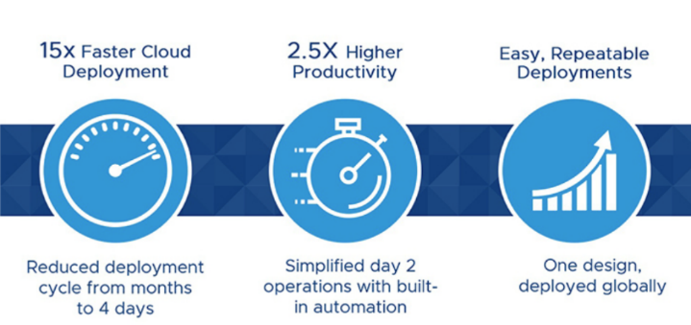
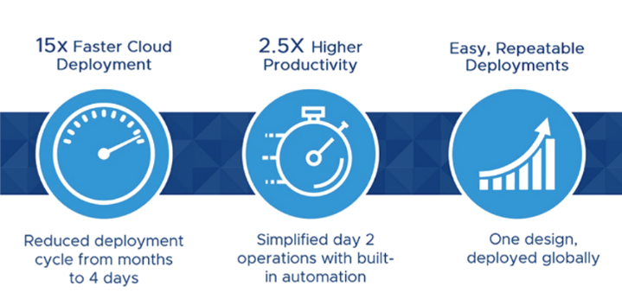
Dell EMC Unity for VMware Cloud Foundation
Versatility of Network Storage for SDDC Hybrid Cloud
Benefits of VCF Hybrid Cloud
First network storage product validated for use with VMware Cloud Foundation
Provision storage for VCF with Unity NFS
Enables Dell EMC’s DIY hybrid cloud platform using best-of-breed storage components
Hybrid Cloud Platforms
DIY Cloud Building Blocks
Reference Architectures
Integrated Cloud Platforms
Public Cloud Platforms
Dell EMC Cloud Marketplace
https://www.dellemc.com/en-us/cloud/hybrid-cloud-computing/index.htm
Notes:
Dell EMC Unity-VMware Cloud Foundation NFS qualification allows customers to implement “Do It Yourself” Cloud Building Blocks to design and build a custom cloud platform using best-of-breed cloud-enabled infrastructure such as Dell EMC Unity, providing flexibility as well as investment protection. Dell EMC Unity is the first NFS-based (i.e. File) external storage array family to be validated with VMware Cloud Foundation. This is a big deal being 1st. It shows customers a tangible benefit of buying the complete Dell Technologies stack and it highlights our Dell EMC Unity engineering investments in VMware vs. our competition’s. For more information about this exciting news, please go to the Dell EMC Cloud Marketplace web site (noted on the slide) after November 12, 2018.
https://www.dellemc.com/en-us/cloud/hybrid-cloud-computing/index.htm

Slide 10
Dell EMC Cloud Tiering Appliance
Free up primary storage resources and IT budget
Automated Tiering/Archiving
Policy-based file tiering, repository migration
Policy-based block snapshot archiving
No change to applications
Immediate Savings
No cost RTU license, improves TCO
Frees up inactive file storage
Reduces backup windows
Deployment Flexibility
Physical CTA, Virtual CTA-VE
High Availability Options for Recall
Secure and Efficient
In-flight encryption
Compression in the cloud
ECS
Public
Public
Private
Private
Dell EMC Unity
CTA
Automated tiering with the benefits of cloud economics
Notes:
Automated Tiering/Archiving
Policy-based file tiering
Seamless file retrieval
Policy-based snapshot archiving
Support for LUNs and Consistency Groups
No end user impact; no change to apps
Immediate Savings
No cost RTU license, improves TCO
Frees up inactive file storage
Reduces backup window
Deployment Flexibility
Physical or Physical-HA
Virtual or Virtual-HA
Secure and Efficient
In-flight encryption
Compression in the cloud
CTA OE Minimum Versions:
File Tiering:
Dell EMC Unity OE 4.1+
CTA 11+
Block Snapshot Archiving:
Dell EMC Unity OE 4.2+
CTA 12+
File Migration:
Dell EMC Unity OE 4.2+
CTA 12 SP1+

Slide 11
Dell EMC Unity: architected for all-flash
3D TLC NAND flash drive
Multi-core optimized for best CPU utilization and low latency
Intelligent flash wear leveling
Zero impact drive firmware based garbage collection
Per object in-memory log for consistent low response time
Write coalescing with full stripe writes to minimize IO
Inline compression
Mix different flash drive types and capacities for lowest cost
Notes:
We say that Dell EMC Unity was designed as “All Flash”. Here are some of its capabilities that back up our statement.

Slide 12
Transactional performance gains with OE 4.3
8K Random Write
Total Random IOPS gains from OE 4.1 with Data Reduction
+64%
+24%
+48%
+39%
+35%
More performance
More complete data reduction
100% Write
100% Read
50:50 R/W
70:30 R/W
80:20 R/W
OE 4.3 results with Full Data Reduction
Based on internal testing with data reduction enabled, 8K block size, performance increased from prior release for both Unity OE 4.2 and 4.3. OE 4.3 includes data compression + zero detect + dedupe. OE 4.1 and 4.2 with data compression only
OE 4.1 results with Data Compression

Slide 13
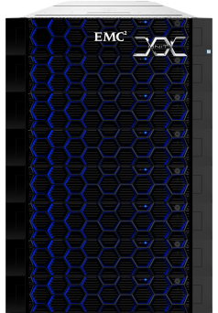
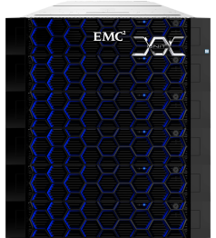
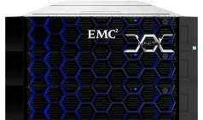
More firepower across the family
Grow with Dell EMC Unity All-Flash
DATA-IN PLACE UPGRADE
Dell EMC Unity 350F
Dell EMC Unity 450F
Dell EMC Unity 550F
Dell EMC Unity 650F
PROCESSOR | 6c / 1.7GHz 96 GB Memory | 10c / 2.2GHz 128 GB Memory | 14c / 2.0GHz 256 GB Memory | 14c / 2.4GHz 512 GB Memory
CAPACITY | 150 Drives 2.4 PB | 250 Drives 4 PB | 500 Drives 8 PB | 1000 Drives 16 PB
LUN | 1000 256 TB | 1500 256 TB | 2000 256 TB | 6000 256 TB
FILE SYSTEM | 1000 64 TB ➔ 256 TB | 1500 64 TB ➔ 256 TB | 2000 64 TB ➔ 256 TB | 4000 64 TB ➔ 256 TB
VVOL | 9000 64 TB | 9000 64 TB | 13500 64 TB | 30000 64 TB
Notes:
The Dell EMC Unity 350F through 650F systems use the more powerful Broadwell chip set with more core per storage processor and each system has double the amount of memory.
This coupled with increases in maximum system capacity, number of LUNs, a 4X larger maximum file system size and file system count, plus extensive Vvol supports let’s Unity meet all of the requirements of our midrange customers even if they only buy one system.

Slide 14
Dell EMC Unity software is all-inclusive
No separate licensing – everything to store, manage and protect data
BUILT-IN SOFTWARE FEATURES
Cloud-based Storage Analytics Get comprehensive array health scores | Thin Provisioning Optimize your available capacity | Unified Management Manage file, block, VVOL objects | Central Management Manage multiple Unity systems | Dynamic Pools Experience faster rebuild times | Forever Snapshots & Clones Flexibly replicate snaps and integrate with iCDM
File & Block Remote Replication Full unified capabilities including Metrosync Manager | Inline Compression & Deduplication Advanced data reduction features with increased efficiency | Software Defined Cloud Storage File/block features that run on premise or in an AWS cloud | Cloud Tiering & Archiving File & block data movement to & from five S3 clouds
Anti-Virus Enabler Connect with popular anti-virus solutions | Data At Rest Encryption Protect business data across the array | QoS (Host IO Limits) Limit host IO or bandwidth to specified block resources | File Level Retention Protect files from modification or deletion | Virtualization Integration VMware, Microsoft, OpenStack
IP Multi- Tenancy Assign isolated partitions to NAS Servers
Limited RTU licenses included for: AppSync Basic and RecoverPoint for VMs
Notes:
We’ve mentioned that each PowerVault ME4 array will include all the software customers will need to store, manage, and protect their data. Similar to Dell EMC Unity and the SC Series All Flash arrays, the PowerVault ME4 Series is all inclusive with enterprise-class software. There’s no additional licenses or costs – it’s all here.
A few of the all inclusive features include:
Adapt or Distributed RAID that protects data and rebuilds failed drives faster
A new 3-Level Tiering feature supporting array efficiency and performance with less hardware expense
VMware vCenter Server provides a centralized platform for managing your VMware vSphere environments, allowing you to automate and deliver a virtual infrastructure with confidence.
VMware Site Recovery offers efficient, simple, and on-demand site to site protection for VMware vSphere environments
and
Data protection features like snapshots, remote replication, and encryption.

Slide 15
Dell EMC Unity replication
Complete Array-based Replication Options
 | Block | File
Native Asynchronous Replication | ✓ | ✓
Native Synchronous Replication | ✓ | ✓
“It is easy to use. Setting up replication is pretty simple. We just set it and forget it.” Storage Admin at a Healthcare Company
“Simplifies our structure, replication, and administration.”
James Sexton, Systems Admin, Farm Bureau Health Plans

Slide 16
Dell EMC’s most federally certified storage
U.S. DoD approved products list
FIPS 140-2
LEVEL 1
IPv6 DUAL
STACK
HIPAA
COMMON
CRITERIA
DATA
AT REST
ENCRYPTION
EXTERNAL KEY
MANAGER
DATA AT REST ENCRYPTION
INTERNAL KEY MANAGER
TLS 1.2
SUPPORT
AND DISABLE
TLS 1.0
KMIP COMPLIANT
STIG CAT 1 AND CAT 2
NATIVE SHA-2
CERTIFICATES
STATEMENT
OF VOLATILITY
Meeting datacenter security requirements
Notes:
United States of America DOD Approved Products List (APL) Certification
Controller-based data at-rest encryption - protects against unauthorized access to lost or stolen drives or systems.
HIPAA - The HIPAA Privacy Rule protects patient confidentiality
TLS 1.2 support - cipher suites that provide enhanced security.
Native SHA2 certificate support - hashing standard used to ensure data has not been modified.
IPv6 dual stack certification - dual stack technology
FIPS 140-2 Level 1 Certification - specifies security requirements for cryptographic module.
Common Criteria Certification international standard (ISO/IEC 15408) for computer security certification.
KMIP compliant – supports KMIP-compliant external key managers, facilitates data encryption by simplifying encryption key management.
STIG CAT 1, CAT2 Compliance – security protocols within networks, servers, computers, and logical designs to enhance security.
Other items not listed here – Energy Star certification

Slide 17
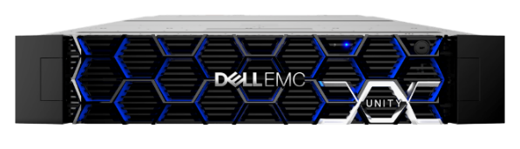
What customers are saying about dell emc unity
“Seamless data migration from VNX, and VDI performance is very good.”
Allen Riviera, Data Center Architect, Iron Bow Technologies
“The array itself is so simple, easy to set up and easy to use, but it still has that great Dell EMC technology behind it.” James Sexton, Systems Admin, Farm Bureau Health Plans
“Some of their recently added feature sets, like the dedupe and compression, they have been a pretty significant improvement.”
Jeff St. John, Design Architect, Alexander Open Systems
“We're happy with the stability. We have not had any issues with it. We run all-flash on two of them and, so far, we have not had any complaints about performance issues.” StorageA18d5, Storage Admin at a Healthcare Company
“The benefits are the simplicity, flexibility and the ease of integration between the Unity platform and VMware, for example, and Microsoft platforms; the integration tools and the simplicity of management.”
Eric Umstead, Director of Technical Services , Tech Services Company

Slide 18
World-Class Dell EMC Services Options
Dell EMC Unity
Support
Deployment
New on Unity!
Optimize for Storage
In-depth analysis & guidance
ProDeploy
Proactive Support
Get ahead of problems before they happen
ProSupport
ProDeploy Plus
ProSupport Plus
Data Migration
A proven vendor-agnostic methodology
Easy connection
to our data-driven
technology
Secure Remote Services
Notes:
Our service offers are designed to help you get the most out of your Dell EMC Unity investment with the technologies and expertise Dell EMC is known for across the globe.
Support
Built on a foundation of experts, tools, technologies and customer ease, our suite of support offers can be chosen to align with the criticality of your systems, complexity of your environment and how you allocate your IT resources. ProSupport provides comprehensive 24x7 support with automated issue detection and case creation. For arrays running critical workloads, ProSupport Plus delivers our most proactive support experience and the add account management expertise via a designated Technology Services Manager and access to senior ProSupport Plus engineers for faster issue resolution.
Take support further with Optimize for Storage – offering in-depth analysis and personalized strategic guidance to keep your Unity systems optimized and configured for year-round peak performance. It’s like a personal coach for your storage system. Your customer will gain the expertise of a designated storage expert who keeps a daily watch on your storage health and identifies areas for improvement. Optimize is an add-on service, complementing ProSupport or ProSupport Plus, available direct and through channel partners.
Data-driven technologies
Secure Remote Services is the proactive automated support technology integrated into our suite of enterprise products and systems management consoles to enable faster resolution and reporting as well as connectivity to CloudIQ.
Deployment
To get up and running fast, ProDeploy provides onsite hardware installation and remote configuration by certified deployment engineers. To prepare for the deployment, we conduct a site readiness review and implementation planning, followed by system validation and documentation of the project.
ProDeploy Plus, our highest level offer, includes always onsite hardware and software configuration for a highly personalized experience. From beginning to end, ProDeploy Plus provides the skill and scale needed to successfully execute demanding deployments. Certified Dell EMC engineers start with extensive environmental assessments and detailed project planning. Post-deployment configuration assistance, testing, and product orientation help you rest easy knowing your systems have been deployed and integrated by the best.
Whether you choose ProDeploy or ProDeploy Plus, we will also set up connectivity to our data-driven technologies and CloudIQ – so you are ready to go on day one.
Data Migration
Intelligent Data Mobility uses a proven vendor-agnostic methodology to migrate data to new technologies, helping organizations transition faster while ensuring a smooth, uninterrupted experience.

Slide 19
Dell EMC Unity: Designed for Simplicity

Slide 20
Ultimate storage lifecycle experience
Dell EMC Unity simplicity considers how people work
STORAGE ADMINS
VIRTUALIZATION ADMINS
APPLICATION OWNERS
Needs to save costs, time without losing resource management control
Implements application & cloud virtualization technologies
Monitors performance & data availability
Unishpere
Unisphere Central
CloudIQ Management
Integrations with vCenter & SCOM
Unisphere Central
CloudIQ Anomaly Detection
Notes:
Unity is SIMPLE across the entire lifecycle of storage –
Simple to buy with all-inclusive software and simple web-based ordering
Simple to setup – you can rack and stack the system in minutes and with the configuration wizard you can be up and running in 15 minutes
Simple to use with a new improved HTML5 based experience (no more java!!) and tight VMware and Microsoft integration means you connect easily to the most common environments.
Simple to support with a CloudIQ-internet enabled platform and proactive assist capabilities- we find out when there are problems on the systems before customers do!
Everything is fully customer installable.

Slide 21
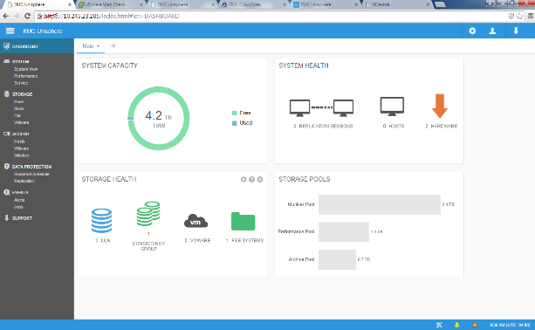
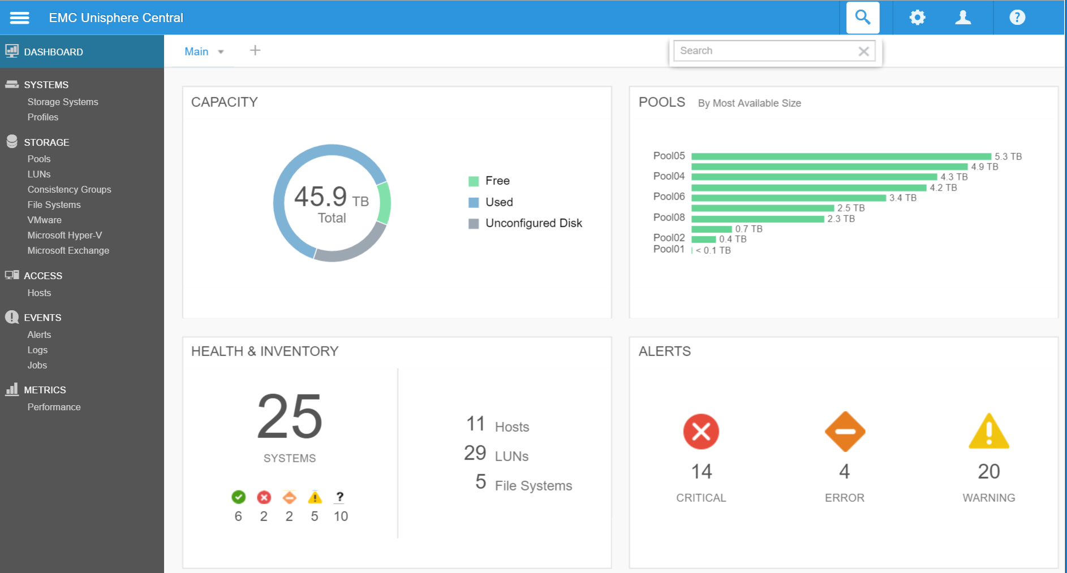
Simple, intuitive management from anywhere
Ease of use; ease of management; ease of deployment; the GUI is very user-friendly.” Allen Riviera, Data Center Architect, Iron Bow Technologies
UNISPHERE
Single array unified management
UNISPHERE CENTRAL
Centralized management
UNIFIED CLI & REST API
Manage from the console
Compatible with most modern browsers
Easy navigation, simple workflows
Modern look and feel
Remotely monitor up to 1000 Dell EMC Unity arrays
View/analyze aggregated metrics for managed systems
Launch Unisphere for individual systems
Easier app integration
Simple http commands
API access from CLI, browser, app and script
Notes:
Dell EMC Unity’s UI is HTML5 based.
CloudIQ delivers on all this as a no cost Software-as-a-Service (SaaS) cloud-based storage analytics application that uses near real-time intelligence, proactive monitoring, and predictive analytics to deliver comprehensive health scores for Dell EMC Unity storage systems.
The 3 major goals of CloudIQ are to reduce TCO, expedite Time to Value and provide Proactive System Health Scores.
Since CloudIQ is a service you will continue to see constant enhancements to the product as we do not have to wait for a specific software release.
And you can now manage Dell EMC Unity using a REST API. The REST API programmers guide is right in the O.E. (operating environment).

Slide 22
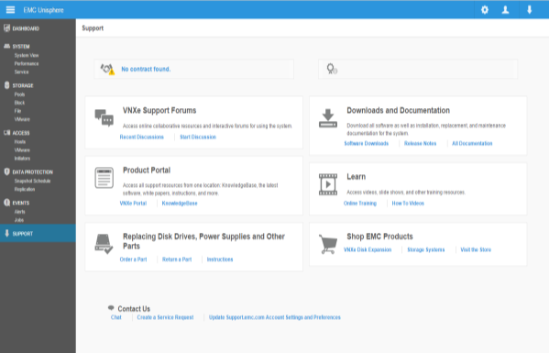
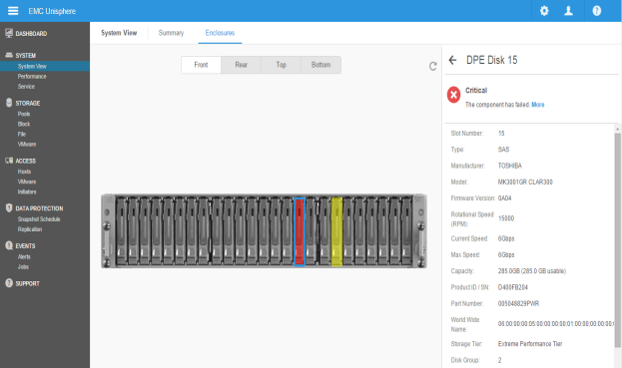
Simplicity extended with proactive assist
Get connected and resolve problems faster
Get Connected And Resolve Problems Faster
Built into Unisphere GUI
System Monitoring
Self Service Portal
“ESG Lab performed an out-of-box installation on a Dell EMC Unity 350F all-flash array that took 25 minutes from opening the packaging until the array was ready to configure host connections and storage. ESG found Dell EMC Unity to be as easy to install as a consumer networked printer, increasing the productivity of anyone doing the installation.”
Notes:
And Unity includes Proactive Assist, a self-service portal with a robust on-line set of community activities (live chat, videos, documentation, and more), direct parts ordering, system views, and dial home assistance.
Notes: Proactive Assist is a Marketing term that includes all the proactive servicing Unity enables, including the new ESRS (Virtual Edition (VE) and ESRS VE Gateway), The carrousel that highlights hardware faults, the chat, the how to videos, etc.
Our proactive management system contains all of the capabilities needed to resolve problems faster than before (based on ESRS data).
Let Dell EMC support troubleshoot your system remotely to fix issues before they cause damage.
Setup email alerts when something looks wrong.
Log into the self service portal to trouble your system
Live chat with an Dell EMC support rep and ask questions to other Dell EMC Unity community members
If a disk fails, you can even order parts directly from the system.
Simplicity
ESG Lab Review: Dell EMC Unity All-Flash Storage Focused on Simplicity, Delivering Advanced Functionality
Date: November 2017
Author: Kerry Dolan, Senior IT Validation Analyst
“ESG Lab validated that the Dell EMC Unity Series is easy to install and configure, due to a combination of mechanical design, web-based resources, documentation, and wizard-driven tools. ESG Lab performed an out-of-box installation on a Dell EMC Unity 350F all-flash array that took 25 minutes from opening the packaging until the array was ready to configure host connections and storage. ESG found Dell EMC Unity to be as easy to install as a consumer networked printer, increasing the productivity of anyone doing the installation.”
“The installation process from unpacking through powering up took less than 10 minutes. We placed the Dell EMC snap-in rails into the rack, secured them with screws, and slid the array into the rails. Next, we recorded the system serial number from the conveniently located slide-out tag at the front of the array. We connected the two management ports to the top of-rack Ethernet switch and connected AC power. The array then began its power up and boot process, which it completed in 10 minutes.“

Slide 23
Globally recognized simplicity
Svetoslav Nanchev, Senior IT Infrastructure Manager
Dr. Zafar Chaudry, CIO
“One month after deployment, Dell EMC Unity All-Flash was running our workloads, with no downtime. It was the easiest data storage migration ever.”
“One of the biggest values of the Dell EMC Unity storage array is that its HTML5 interface is so simple and intuitive that it’s “changing the staffing model” at Cambridge University Hospitals.”
Riccardo Ferrari, Head of Systems Operations
“Implementation of the new all-flash storage platform was quick and easy. Once the Dell EMC Unity All-Flash was up and running, migration was also simple — with storage for all the servers, applications and VMs moved in less than one month, with no downtime or any special support required.”
Jeff St. John, Design Architect
“It's the simplicity part of it. It's the ease of management, it's the call home, the CloudIQ functionality. It's all built in.”

Slide 24
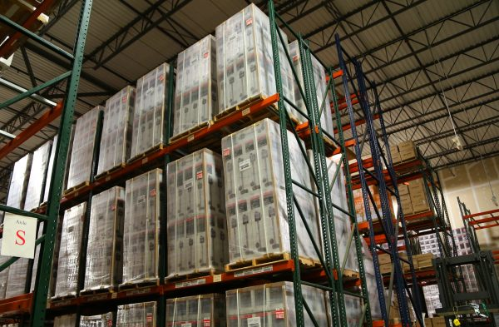
Supply chain experts streamline & simplify logistics management with Dell EMC Unity
Challenges
Data growth overloading legacy storage
Poor application performance sapping employee productivity
Solutions Applications
Dell EMC Unity
VMware vSphere
Results
Improved I/O performance by 1,600 percent
Reduced heavy-duty reporting from four minutes to 30 seconds
Simplified LUN reconfiguration from 24 hours to nearly instantaneous
Shrunk data center footprint from 20 to two rack units
Microsoft SQL Server & Dynamics
Manhattan Associates & TMW Systems
“People notice how much faster everything is now. They don't need to sit around waiting for reports anymore."
John Zei Senior Director of IT Services
“Everyone is more productive."
Notes:
Here is a Dell EMC Unity customer. You can see the benefits realized are tremendous compared to that of their previous storage provider’s product.

Slide 25
Dell EMC Unity Newest Features (OE 4.5)

Slide 26
Dell EMC Unity inline data reduction
Full end-to-end data efficiency capabilities
0000000000000000000000000000
0
+ & % +
& + + $
# $ + %
@ + % $
+ & %
$
#
@
Zero Detect
Deduplication
Compression
Dynamically deduplicates considering all data patterns
Data reduction in memory before being written to flash
Unified data reduction applicable to file and block data
Flexible on/off settings per LUN, file system, and data store
Reduce the amount of physical storage needed to store incoming data
Easily manage data reduction via Unisphere, Unisphere CLI, or REST API
Notes:
Inline data reduction innovation continued with Dell EMC Unity OE 4.4. The business and technical benefits listed on this slide reflects the overall Unity Data Reduction advantages as of OE 4.4

Slide 27
Introducing “Advanced Deduplication”
Deduplication
Efficient: Introducing Advanced Deduplication to eliminate multiple copies of similar data blocks to boost storage efficiency
Standard
(Eliminates zeroes and known patterns data blocks)
Simple: Controlled by an Advanced Deduplication switch under an exiting Data Reduction option
Advanced
(Eliminates All duplicate patterns data blocks)
New
in OE 4.5
“DATA REDUCTION” DATA FLOW
Unified: Settable at per LUN/File System/Data Store level
Supported on High End All-Flash Platforms – Dell EMC Unity 450F, 550F, 650F.
Compression
BLOCK
FILE
Notes:
In-line data reduction innovation continues with Dell EMC Unity OE 4.5. In this release, we’re improving the deduplication capability by providing advanced dynamic pattern detection that considers all data patterns enabling your customers to see up to 3 times overall data reduction savings with increased efficiency. This update is applicable to both file and block data.
This new capability will be listed as “Advanced Deduplication” and located in Unisphere as a checkbox under the exiting “Data Reduction” checkbox.
As a reminder, the “Data Reduction” checkbox is supported on All-Flash pools on all platforms enabling “Zero Detection” along with the elimination of known data patterns.
The “Advanced Deduplication” checkbox has been added under the exiting “Data Reduction” checkbox.
The “Advanced Deduplication” checkbox is only supported on the Dell EMC Unity 450F, 550F and 650F platforms. “Advanced Deduplication” adds the capability to eliminate all duplicate data patterns.
“Data Reduction” is a pre-existing checkbox supported on All-Flash pools on all platforms which enables “Zero Detection” along with the elimination of known data patterns.
--------
All the existing LUNs and File Systems post NDU should be able to take advantage of the “Advanced Deduplication” capabilities on the supported platforms in order to maintain backward compatibility.
The “Advanced Deduplication” domain is at the per LUN/FS. However, since it’s in-line, all of the “Advanced Deduplication” enabled objects will share the available system memory. The Domain represents an ability to eliminate the duplicate data blocks which reside within the defined boundary.
A Storage Pool can have some LUNs and File Systems with “Advanced Deduplication” enabled and others disabled. The same is true for NAS Servers and Consistency groups.

Slide 28
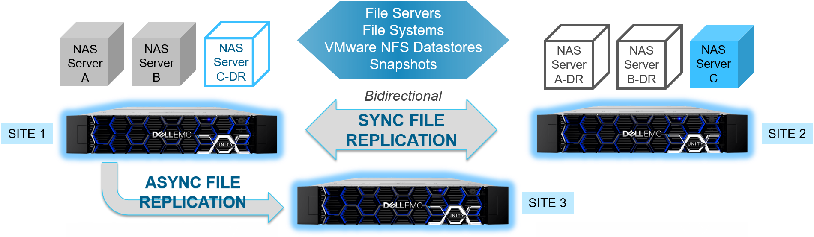
Metrosync Manager
New in OE 4.5
Automates failover detection and enables rapid failover
Optional software to manage and automate Metrosync (Synchronous File replication) sessions
Minimize downtime by continuously monitoring the replication sessions and automatically initiate failover when issues are detected .
User interface displays details about the Metrosync session
Lightweight implementation – runs on a VM
Notes:
Dell EMC Unity Metrosync Manager:
The previously-released Metrosync for Unity synchronous file replication is now enhanced with the addition of orchestration with Metrosync Manager. The latter enhances the granular replication and failover capability of Metrosync with additional status monitoring and automation in the event of an outage at either site. Metrosync Manager will trigger the automatic failover based on NAS Server, file system, and IP unavailability that would cause the client to lose access to data.
The new Dell EMC Unity Metrosync Manager capability acts as the witness for monitoring both sides of the synchronous file replication, detecting an outage and automatically failing over all of the synchronized NAS Sever(s) and constituent filesystems and configurations from the source to target. The storage administrator selects and configures one or more NAS Server(s) on the source Unity system for which connection would be automatically be moved to a target Unity system upon the failure/unavailability of the source, triggered during conditions such as both SPs being down or during rolling panics.
The objective is to have zero data loss when the NAS Servers are brought up on the target system (MetroCluster like functionality). Automatic failover (at metro distances of up to 100 kms) should be transparent to clients - IP address, file handle, snapshots and schedules will be preserved and available at the failover site. The source and destination can be configurable in a bi-directional manner (Active-Active) to protect both sites. Unlike VNX2 however, Unity Metrosync Manager should ensure that the Dell EMC Unity solution can use a single instance for setting up a bi-directional configuration.

Slide 29
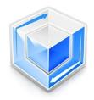
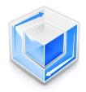
Dell EMC UnityVSA adds native HA
New in OE 4.5
Fast, efficient path to software defined storage
Dell EMC UnityVSA
Hypervisor Agnostic
COMMUNITY
EDITION
PROFESSIONAL
EDITION
NATIVE HA SOLUTION
New
Dual Node with Tie Breaker Node
HTML5
UNISPHERE
NFS | CIFS | iSCSI
Move SDS into production
4TB CAPACITY LIMIT
COMMUNITY SUPPORT
FREE DOWNLOAD
10TB, 25TB, 50TB
DELL EMC SUPPORT
SUBSCRIPTION LICENSE
FILE
BLOCK
VVOL
VVOL
VSI | ESI
ESA | VAAI
REST API
RAPID DEPLOYMENT USE CASES
REPLICATION
SNAPSHOTS
PRODUCTION ENVIRONMENT
REMOTE BRANCH OFFICES
LOW-COST STORAGE
RETAIL | EDUCATION | HEALTHCARE | CLOUD
NAS
SCALEIO & VSAN SPPT
TEST / DEV ENVIRONMENT
VMware ESXi
Notes:
For customers interested in implementing a software defined storage strategy, we have always had a virtual and downloadable version of the Unity code base for this purpose called Dell EMC Unity Virtual Storage Appliance or UnityVSA.
With Dell EMC Unity OE 4.5, we have added native high availability for the Professional Edition with this new offering -
A UnityVSA HA Professional edition is newly offered as 2 node, 2 core, Tie Breaker Node, for 10, 25, and 50TB capacity offerings
There is no change to the current UnityVSA Professional edition with single node, 2 core, for 10, 25, 50TB capacity offerings. supported in VMC
And there is no change to the UnityVSA Community Edition with single node, 2 core, 4TB capacity
The new UnityVSA Tie Breaker Node or witness node is a lightweight 3rd member of the cluster to arbitrate in the unlikely event all communication is lost between the 2 nodes in order to avoid data corruption. (It’s also known as avoiding the split brain scenario.)
The same license for the current single node Professional Edition activates the Professional Edition dual node at the respective capacities.
As a reminder, the Community Edition is no cost to download and use. It ‘s available with no support and should be positioned for test/dev purposes only.

Slide 30
File-Level Retention
New in OE 4.5
Keeps businesses in compliance with file data retention policies
Protects files from modification or deletion until a specified retention date
Files
Files
Files
Creates permanent, unalterable set of files & directories to ensure data integrity
Safeguards data by ensuring accessibility
Simplifies the task of archiving data for administrators
FLR-E: protecting data from changes made through CIFS, NFS, FTP
FLR-C: same as FLR-E plus meets SEC rule 17a-4(f)
Improves storage management flexibility
Native file migration from VNX
Notes:
File-level retention (FLR) capability is included with Dell EMC Unity 4.5 for protecting files from modification or deletion until a specified retention date. FLR allows you to create a permanent, unalterable set of files and directories and ensure the integrity of data.
There are two different types of file-level retention available: Enterprise (FLR-E) and Compliance (FLR-C).
Enterprise FLR-E protects data content from changes made by users through CIFS, NFS, and FTP.
Compliance FLR-C protects data content from changes made by users through CIFS, NFS, and FTP, from changes made by administrators, and also meets the requirements of SEC rule 17a-4(f).
An FLR-enabled file system:
Safeguards data by ensuring integrity and accessibility
Simplifies the task of archiving data for administrators
Improves storage management flexibility
Supports Replication, Snaps, NDMP backups/restores, File migration, Data Reduction

Slide 31
Dell EMC Unity Technology Features

Slide 32
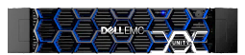
Architecture does matter
Your Dell EMC investment is working 100% for your business
SAN
SAN
Active
Passive
Active
Active
?
Why isn’t this resource being used?
Basic Mid-Range Offerings
Advanced Mid-Range
Notes:
Unity backend is a true active-active architecture
Dell EMC Unity utilizes a dual-active architecture, meaning both controllers are active and serving IOs, whereas the block device will utilize an Asymmetrical Active / Active access.
The multicore optimized technology allows the system to access the drives at the same time from each controller. To achieve this, we implemented a region-locking mechanism. In Dell EMC Unity there is no trespass for a backend operation or fault scenario. For example, if there’s an issue with SP A, SP B can access the drives without a trespass.
For the frontend, our Asymmetric Logical Unit Access (ALUA) implementation allows the system to internally redirect IO to the correct SP in the case of a host path failure without the need of a trespass operation. Also, in the case of a host misconfiguration, Dell EMC Unity’s multicore optimized technology can detect the IO redirects to the non-preferred path and automatically resolve it to restore optimal performance.
Dell EMC Unity is architected for:
Workload: General Purpose/Multi- Protocol
Max Performance: 300K IOPS/18GBps
Data Efficiency: Inline Compression, Snapshots, Thin Provisioning
Key Feature: Simplified and Truly Unified SAN & NAS
Mid range offerings
Pure and Nimble

Slide 33
Expandable Dynamic Pools
Maximize performance & efficiently save space and budget
TRADITIONAL POOL
DYNAMIC POOL
+
+
+
+
Flash drives – as needed
ADD SINGLE
DRIVE TO POOL
HIGHER SPACE UTILIZATION
FASTER
REBUILD TIME
SIMPLER AND
LOWER TCO
Flash drives
RAID Widths & Spares
Distributed sparing and flexible pool size
Notes:
Key benefits of dynamic pools are faster rebuild times and ability to expand a pool using single drive as long as the minimum drive criteria is met. Dedicated hot spares are not required for dynamic pools since a portion of space is reserved from all the drives in the pool to serve as hot spare.
While creating a dynamic pool, user needs to select the RAID type and the system automatically populates the RAID width based on number of drives in the system. If user needs to be able to select the RAID width, then that can be done via UEMCLI only and not via Unisphere.
Dynamic pools are supported in all flash configurations only and NOT supported in hybrid configurations.
Dynamic pools do not require hot spares. Space which has been reserved within the dynamic pool for rebuild operations is utilized to rebuild a faulted drive. Once the spare space is consumed, it must be replenished. If a spare drive exists within the system and it is considered a suitable replacement for the drive that failed, it will be consumed by the dynamic pool to replenish the reserved space. If no suitable replacement exists, based on the sparing rules and hot spare matrix, once the failed drive is replaced it will be consumed by the dynamic pool.
(Dynamic pools do not require dedicated hot spares unlike traditional pools. The hot spare capacity is reserved from all the drives within the pool. 1 drive worth of spare capacity is reserved for every 32 drives in the pool per drive type.)
Evenly uses flash
Maximizes performance
Provides more flexibility
Easily and faster rebuild drives than traditional RAID making your data safer

Slide 34
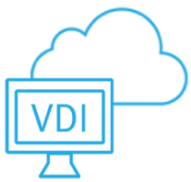
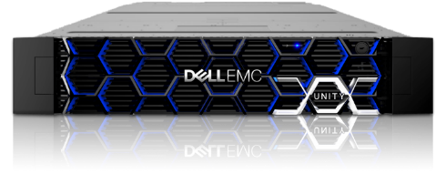
Dynamic All-Flash File
4X more file power for transactional and traditional NAS
256TB SCALE-UP
FILESYSTEM
Scales to 256TB usable capacity per file system with 10M+ sub-directories and files
INLINE DATA REDEUCTION Pointer based snaps with simple space reclaim and low IO impact
FILESYSTEM SHRINK
Reclaim free blocks and shrink file system to reflect new capacity
VMDK
IMPLEMENTATION
Independent VMDK clones with up to 256 clones across multiple levels
FLEXIBLE SNAPSHOTS
Pointer based snaps with simple space reclaim and snap mobility to remote site
SIMPLIFIED
QUOTAS
User and Tree Quotas with ability to change online
u64 File System

Slide 35
Synchronous File Replication
Sync file replication to mirror site within metro distance
Snapshots (scheduled or user-initiated) replicated to mirror site
Zero RPO solution for NAS data and file-based applications
Extension/shrink of source replicated to mirror
35
Notes:
Based on the costs of application downtime and data loss as tabulated by industry analysts, data loss or application downtime are situations that can cost organizations millions of dollars per event. This new release brings broader opportunities for Dell EMC Unity customers to leverage NAS for critical data and applications based on expanded DR solutions through synchronous file replication. Synchronous Replication for File will enable customers to mirror a site (file servers and file system data) to DR locations within metro distances - including scheduled and user manual snapshots. With its Zero RPO option for critical file-based applications and data, Dell EMC Unity’s synchronous replication for file can save customers millions of dollars in the event of a primary site outage by enabling failover of NAS servers and file systems.

Slide 36
Dell EMC Unity snapshots
✔
Supports snapshots of snapshots up to 10 levels deep
Multiple
mounts
✔
All snapshots are writable
and mountable
Snap 1
Snap 1.1
Snap 1.2
Snap 1.3
✔
Refresh any snapshot
from any other snapshot
Snap 2
Snap 2.1
Integrated Scheduler
✔
Built-in scheduler for
simplicity of management
Snap 3
Total 256 per LUN
✔
Enable separate QOS limits
on each snapshot and LUN

Slide 37
Snapshot Backup and Archive
Snap 1
Snap 1.1
Snap 1.2
Snap 1.3
Snap 1
Snap 1.1
Snap 1.2
Snap 1.3
Snap 2
Snap 2.1
Snap 2
Snap 2.1
Snap 3
Snap 3
Retention period = 7 days
Retention period = 90 days
Retention period = 50 years

Slide 38
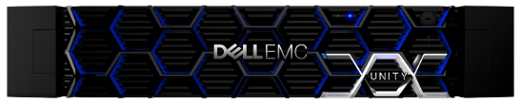
2-Way NDMP support
BENEFITS
Transfer data directly between Storage Array & Tape Library Unit (TLU)
Direct attached eliminates backup data on the network
Improves backup times
Offsite backup for disaster recovery
DMA
Metadata
Data
LAN or WAN
Data
Metadata
Data
Primary System
Secondary System
(TLU)
Data
Data
FC Connectivity
Notes:
Transfer data directly between Storage Array & Tape Library Unit (TLU)
Use dedicated higher speed FC network for data transfer
Direct attached eliminates backup data on the network
Data residing on NAS devices is backed up directly to tape media
Improves backup times
Data goes through FC connection with less overhead over FC
Offsite backup for disaster recovery
Have a third copy of the data
Compliance
ONLY Backup Application and LAN would be the bottleneck

Slide 39
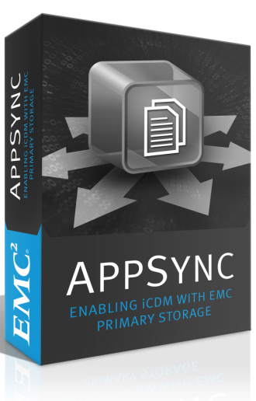
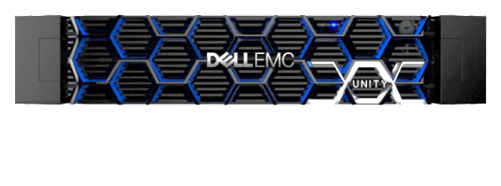
Automated iCDM with AppSync
Minimize copy costs, extend the value of AF storage with app-aware copy data management
Challenge: Everyone Needs a Copy
Different stakeholders
Different applications
Different storage
Different destinations
Data protection
Solution: Application-aware Automation
SIMPLE: One stop shop for copy creation & scheduling across applications with self service for app owners
SMART: Automates discovery and awareness of applications & copy/replication services relationship & adapts to changes
AppSync iCDM Starter Bundle for Dell EMC Unity
FRICTIONLESS: Applications owners & storage admins are on the same page with a transparent copy workflow
Notes:
With the Q2’17 release Dell EMC Unity supports iCDM. Dell EMC Unity can be leveraged to create performant, space-efficient copies without impacting production (within the specified limits). These copies (snapshots and thin clones) are integrated and managed through AppSync providing the application developer a self-service portal to create and manage space efficient copies.
AppSync Features and Strengths
Application-aware, automated workflows with self-service for:
Single UI across applications with app-consistent copies
VMware Datastore copies with VM-level recovery
File System copies for other apps
Copy data provisioning
Instant data refresh and restore
Integrates with RecoverPoint
Application, VM, and storage-consistent copies
Self Install, Host Plug-In automatically pushed
Life cycle management including scheduling, retention and copy expiration
Policy based, easy to use workflows
Admins only work with databases, no need to know about any storage details
Snaps, Clones and RecoverPoint Bookmarks
SLO based Monitoring and Reporting
Visibility into copies and how they are being used
End-to-end Repurposing
Fully integrated with databases
Includes host and database operations to bring the database up on the copy
Copy Management Use Cases
Operational Recovery Flows
Data repurposing for Oracle and SQL
Accelerate backup process
Dell EMC Unity
Automated capacity efficient copy technology built into Dell EMC Unity
Space Efficient Snapshots – archive to cloud and remote backup
Space Efficient Thin Clones with Data Services
Starter Bundle
20 mounted copies; Single array; Local Protection only; Get the full license for unlimited use
Value of Copy Data Management
Empower DB/Application teams with their own lifecycle copies instantly & with no space or SLA impact
No need for full copies: more copies residing on less storage
Limit trade-offs between cost, performance, agility, & scale
Reduce the cost for application test/dev, analytics environments
Everyone Needs a Copy
Different stakeholders
Test and Dev groups
Analytics
Different storage
Different applications
Different destinations
Data Protection
Snapshots
Supports snapshots of snapshots up to 10 levels deep
All snapshots are writable and mountable
Refresh any snapshot from any other snapshot
Built-in scheduler for simplicity of management
Enable separate QOS limits on each snapshot and LUN
256 Snapshots per LUN
Multiple mounts
Thin Clones
Created from the snapshot with shared blocks with LUN
Deduplicated / shared data set
Independent LUNs
Independent snap / replication schedules
Fast create/populate and restore
Enable separate QOS limits on each snapshot and LUN

Slide 40
Data at Rest Encryption
Controller-based encryption for maximum protection and flexibility
Encrypts all user data on the array—at the drive level
All Dell EMC Unity data services supported
Embedded internal key manager
Key Management Interoperability Protocol (KMIP) compliant
Advanced Encryption Standard (AES) - 256 encryption
Drive vendor and type agnostic
Allows use of any drive type
Eliminates drive vendor specific overhead
No impact to data services
No performance impact
External Key Management
Notes:
Unity arrays support controller-based data at rest encryption or D@RE
D@RE uses Advanced Encryption Standard (AES) 256 encryption is FIPS-140-2 Level 1 validated.
Designed to protect against physical disk loss, Controller-based D@RE encrypts the entire array with minimal performance overhead and works with both file and block data. D@RE supports ALL drives, and ALL Unity features. The key management is embedded with a unique key for each drive.
Data at rest encryption is a requirement for Healthcare, Government, and Financial environments. The key use cases are for physical disk security and in some cases can eliminate the need for data erasure services.
ALL Unity arrays have to be DAR enabled at POS before leaving the factory. DARE is no cost to thee customer if they decide to enable it. Once shipped, Unity cannot be DARE enabled. Upgrades are not available.
Encrypts all user data by license
Encrypts Vault and System Partition by default
All Unity data services supported
Embedded encryption key manager
Advanced Encryption Standard (AES) - 256 encryption
Encryption/decryption occurs at the SAS controller level as data moves to and from backend disks
Supported on embedded SAS ports and SAS SLICs

Slide 41
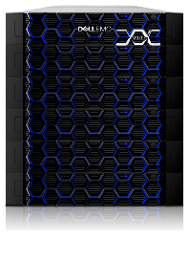
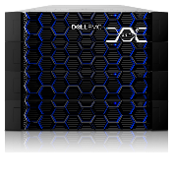
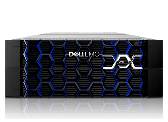
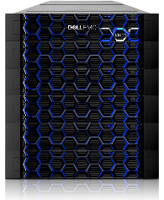
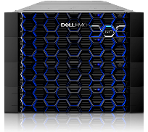
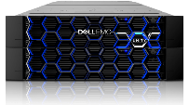
Dell EMC Unity on-line upgrades
16PB
1000 drives
8PB
500 drives
4PB
250 drives
2.4PB
150 drives
In-family Data-in-Place upgrades
All-Flash to All-Flash
Hybrid to Hybrid
On-Line - No system down-time
Customer/Partner installable
All-inclusive software intact
ONLINE DATA-IN PLACE UPGRADE
Unity 350F Unity 300F
Unity 450F Unity 400F
Unity 550F Unity 500F
Unity 650F Unity 600F
16PB
1000 drives
8PB
500 drives
4PB
250 drives
2.4PB
150 drives
ONLINE DATA-IN PLACE UPGRADE
Unity 300
Unity 400
Unity 500
Unity 600
Notes:
Our new portfolio now includes the SCv3000 and the recently announced SC5020 array. From the SCv3000 and up, the software features are available across all platforms. The exception is that the SCv3000 will not support deduplication.

Slide 42
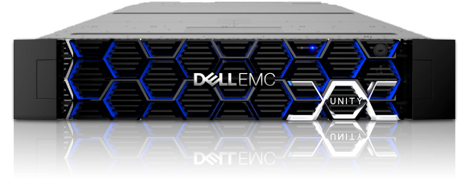
Simple, seamless built-in data migration
VNX1 & VNX2
Integrated Migration
Dell EMC UNITY
FC, iSCSI, NFS and CIFS/SMB migration from VNX
Migrates LUNs, file systems, quotas, ACLs, and exports
Built-in solution: self-service without requiring any third party tool
Transparent to file applications, minimally disruptive for block

Slide 43
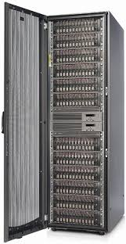
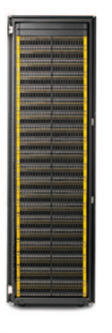
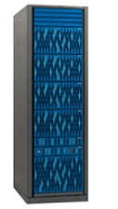
Third-party block data migration
Leverage SANCopy – nothing to install on hosts
Manage with CLI or REST API
Support Migration functionality like pause/resume, create, delete, rollback, throttle
Ability to test destination before cutover
Migrate multiple volumes at the same
Report real-time migration metrics.
Support Planned for:
HP EVA
HPE 3PAR
HITACHI HDS
NETAPP FAS
Plus: Dell EMC VMAX, SC Series & PS Series
Notes:
Additional features:
Support volumes, consistency groups and VMware datastores as part of migration.
No upgrade of software on source should be required for migration.
Host O/S Support as defined in the support matrix for the source and destination platform (Microsoft, VMware, RHEL and Suse Linux, x86 based OS and hosts, AIX, Solaris, HPUX) across clustered and stand-alone servers.
Supported through CLI/REST API - No support in Unity GUI
Up to 2 concurrent sessions per SP for physical Unity systems, up to 1 concurrent session per SP for UnityVSA.
Planned source support for:
HP EVA
HPE 3PAR
Hitachi HDS
Source Support also planned for:
SC Series
PS Series
VMAX

Slide 44
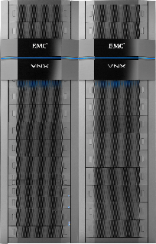
Why refresh to Dell EMC Unity
Refresh your VNX Systems with Dell EMC Unity
Expand & enhance customer investments
Dell EMC Unity vs VNX
Footprint 71% improvement (7U to 2U)
Cabling 80% improvement (6 cables vs 30)
Power 53% improvement (703W vs 1495W)
Install time 90% improvement (2-5 min vs 60 min)
Performance 3X increase
Data Reduction Inline compression & dedupe
File system 1600% improvement (256TB vs 16TB)
Plus
Non-disruptive file & block data migration from VNX
Improved Data Reduction
Density: 613TBe per Rack Unit (2U+3U Expansion)
All-inclusive software
DoD approved security
Comparisons based on VNX5800 to Dell EMC Unity 650F

Slide 46
Dell EMC Unity vs competitors Leading Scalability, Flexibility and Ease of Use
 | Dell EMC Unity | NetApp AFF | Pure \\m | HPE Nimble
Protocols | Unified | Unified | SAN | SAN | Unified
Processors | Broadwell | Broadwell | Haswell | Purley | Ivy Bridge
Max. Memory | Up to 512GB | Up to 1,024GB | Up to 1,024GB | Up to 256GB | Up to 385 GB
Max. Drives | 1,000 Drives | 480 Drives | 136 Drives | 288 Drives | 480 Drives
Max. Raw Capacity | 16PB Raw | Up to 7.3PB | Up to 0.512PB | 1.1PB | 7.3 PB
Storage Efficiency | Inline Compression, Zero Detect, Dedupe | Compression, Zero Detect, Dedupe | Compression, Zero Detect, Dedupe | Compression, Dedupe | Compression, Zero Detect, Dedupe
Data Reduction | Block and File | Block and File | Block | Block | Block and File
Effective Capacity | 34PB Avg. Effective | 30PB Effective | 1.5PB Effective | 4.1PB | 22.1 PB
Max Density per Rack U | 614TBe per RU | 638TB per RU | 203TB per RU | 184TB per RU | 553 per RU
Capacity/File System | 256TB Max. File System | 100TB Max. File System | N/A | N/A | 64 TB Max File system 256 TB Max / node pair
File Replication | Sync (MSM) + Async | Sync + Async | None | None | Async
Controller Upgrades | On-line DIP upgrades | Off-line DIP upgrades | On-line DIP upgrades | On-line DIP upgrades | Limited DIP
Global Management | CloudIQ | Active IQ | Pure 1 | Infosight | Infosight

Slide 47
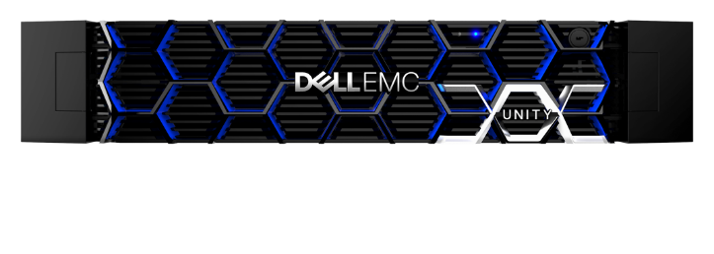
Dell EMC Unity performance
Dell EMC Unity | Unity 350F | Unity 450F | Unity 550F | Unity 650F
Max IOPS | 543,000 | 1,360,000 | 1,644,000 | 2,037,000
Max IOPS with latency <1ms | 262,000 | 507,000 | 509,000 | 899,000
Max IOPS with latency ~1ms | 330,000 | 676,000 | 671,000 | 1,238,000
Unity Latency (ms) | Unity 350F | Unity 450F | Unity 550F | Unity 650F
Max IOPS | 5.37 | 4.37 | 3.64 | 5.60
Max IOPS with latency <1ms | 0.73 | 0.76 | 0.75 | 0.85
Max IOPS with latency ~1ms | 1.15 | 1.13 | 1.14 | 1.23

